Slide 1
Habitats

Slide 2




Learning outcomes
Know the definition of a habitat.
Be able to describe some ways in which habitats are different from one another.
Be able to describe why certain animals are found in some habitats and not others.

Slide 3
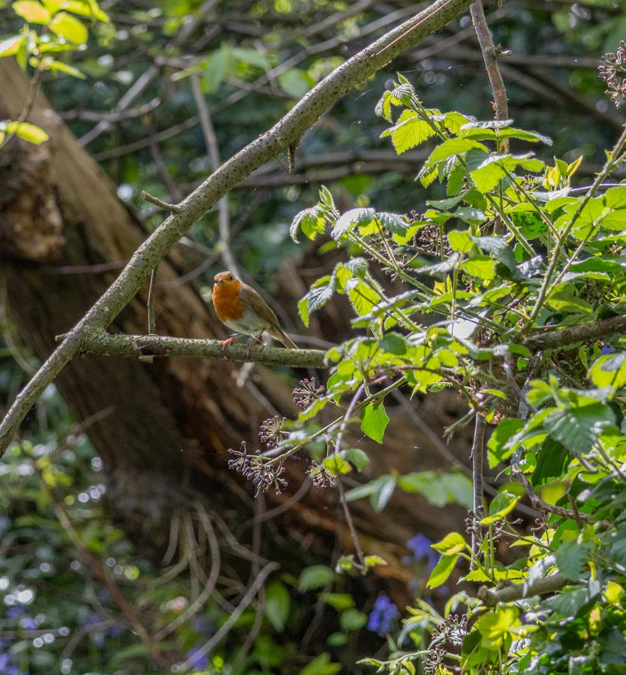
Habitats
A habitat is the place where something lives.
Habitats provide plants, animals, and other living things with the right amounts and types of water and food (nutrients) they need to survive.
Notes:
Water can vary in being salty or fresh, moving or still. These, and other qualities, affect what plants and animals can survive in a habitat.

Slide 4
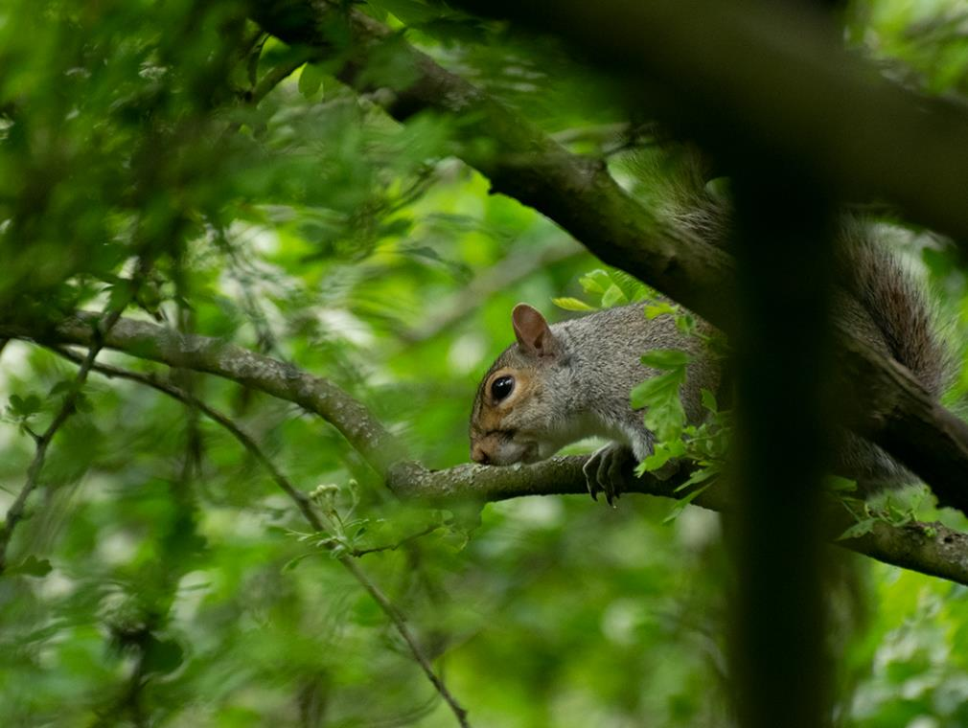
What is the habitat of a squirrel?
Notes:
Trees
Woods
Forests

Slide 5
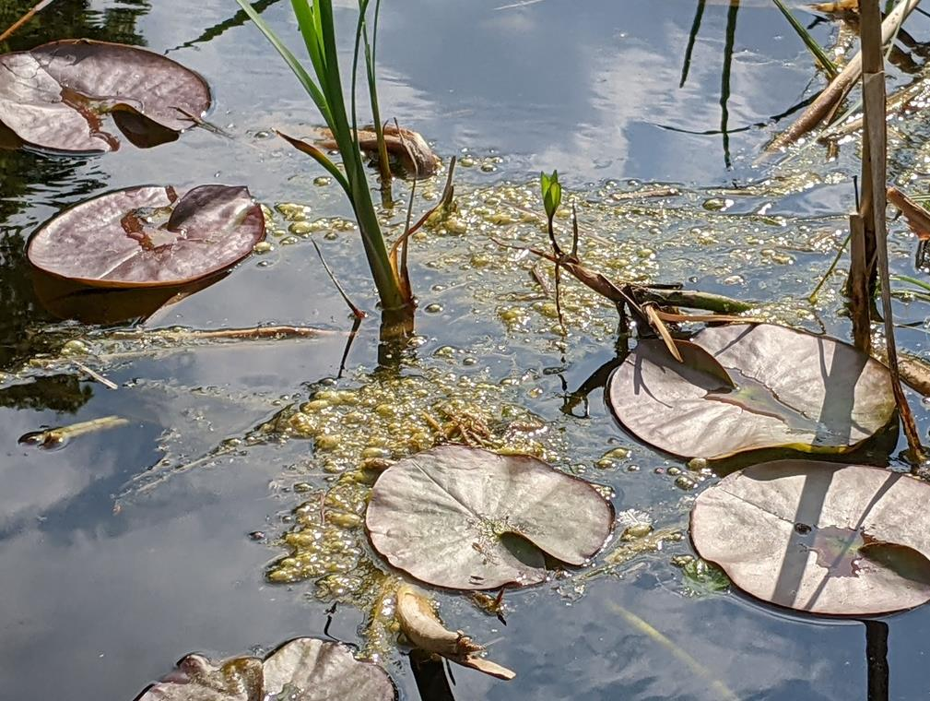
What is the habitat of a water lily?
Notes:
Water
A pond
A wetland

Slide 6
Why does something live in one habitat and not another?

Slide 7
Why does something live in one habitat and not another?
Thinking about what plants and animals need to live can help us answer this question.

Slide 8
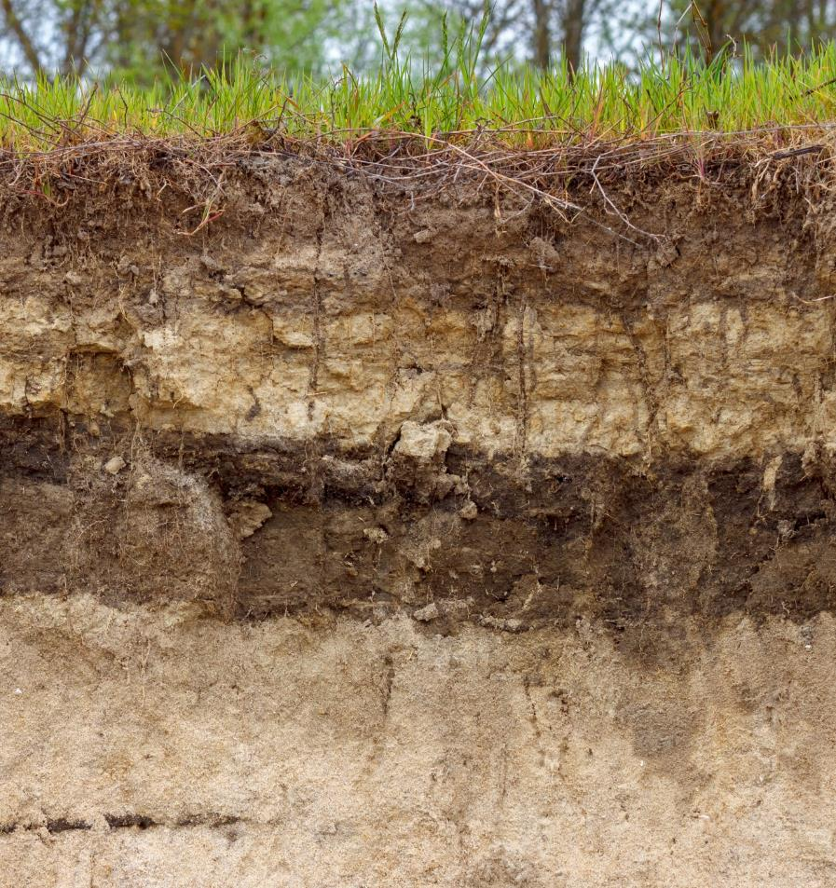
What do plants need to survive?
light
food
water
carbon dioxide
The type of soil in a habitat affects the water and food (nutrients) a plant can get.
Alexey Slyusarenko/stock.adobe.com
Notes:
Plants make sugar from sunlight, carbon dioxide, and water. They still need minerals and other nutrients, which they often get from soil.

Slide 9
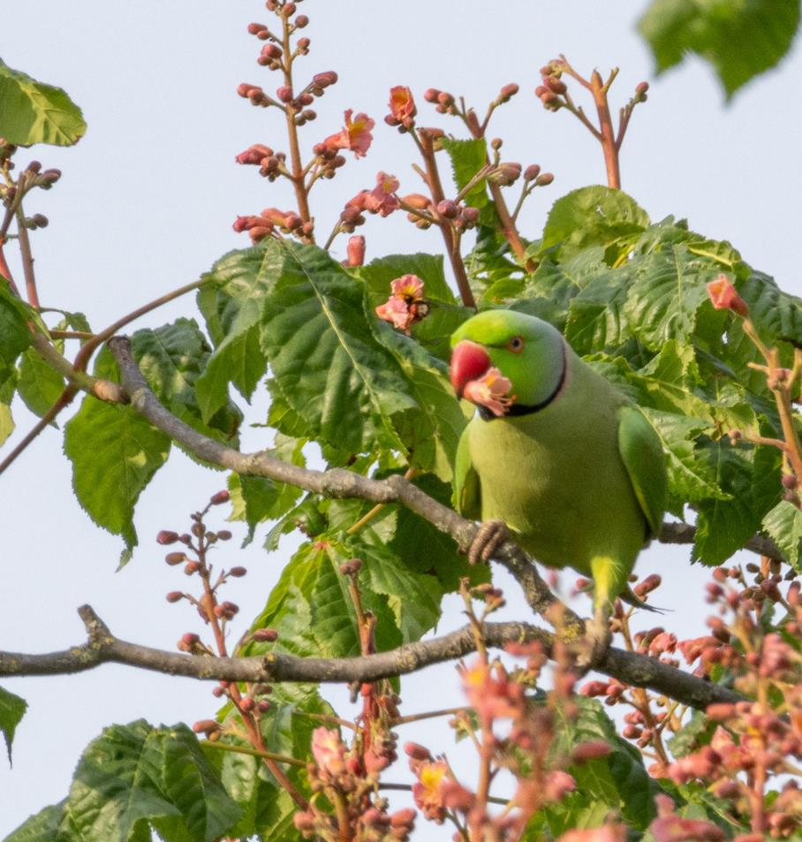
What do animals need to survive?
food
water
oxygen
shelter
The type of plants living in a habitat affects the food that animals can get.

Slide 10
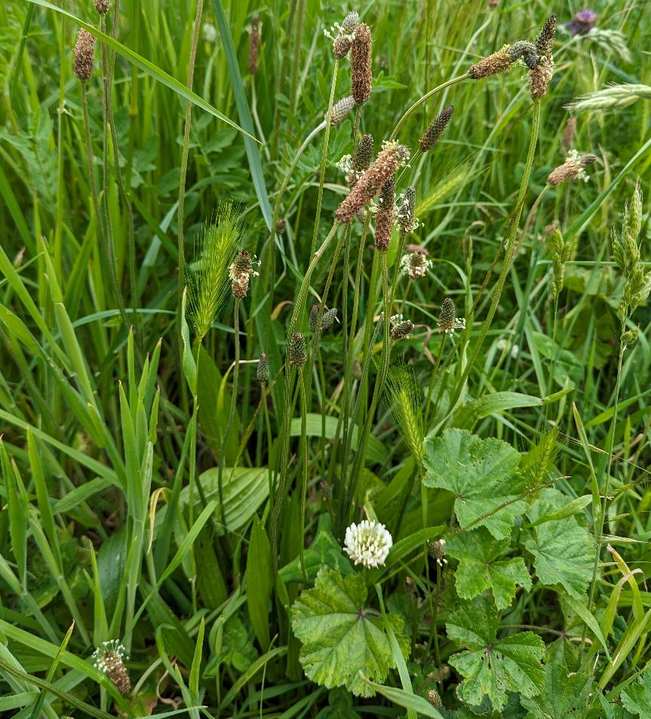
Classifying habitats
Different habitats usually have different soil and receive different amounts of precipitation (rain and snow). Plants depend on water and soil to survive.
We can often classify a habitat by looking at the plants living there.

Slide 11
Look at the habitats on the following slides.
List some ways that the habitats are different.

Slide 12
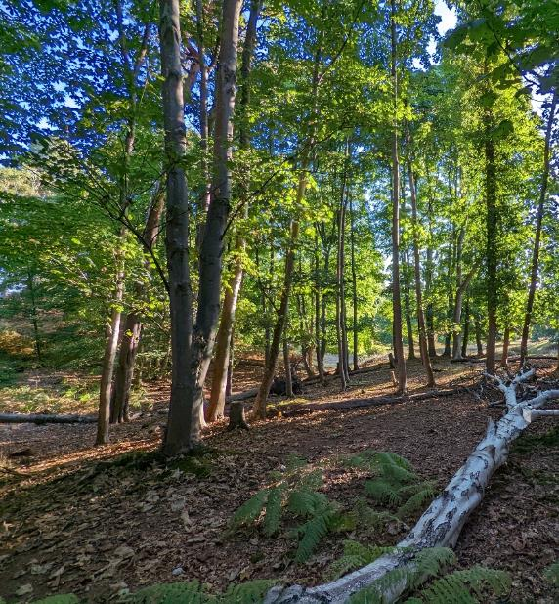
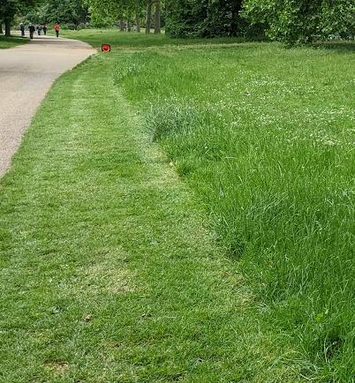
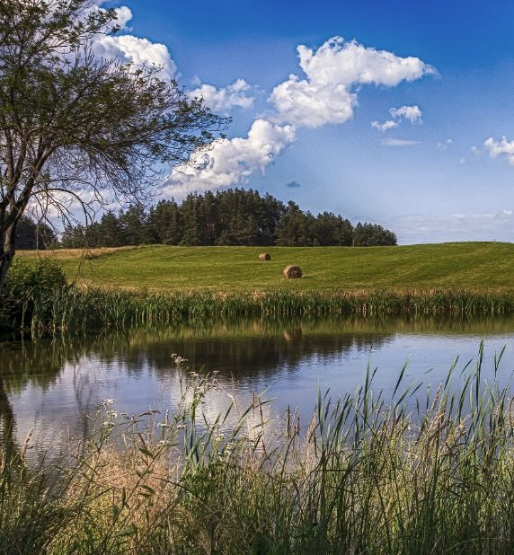
Habitats in the UK
Woodlands
Grasslands
Wetlands

Slide 13
Challenge question:
Are there any animals that live in all three habitats?
What animals might live in a:
- woodland?
- grassland?
- wetland?
How do animals depend on the plants growing in these habitats?

Slide 14
Looking closer at habitats

Slide 15
There is more than one type of woodland, grassland, or wetland.
Look closely at the pictures on the next slides, what differences can you see?

Slide 16
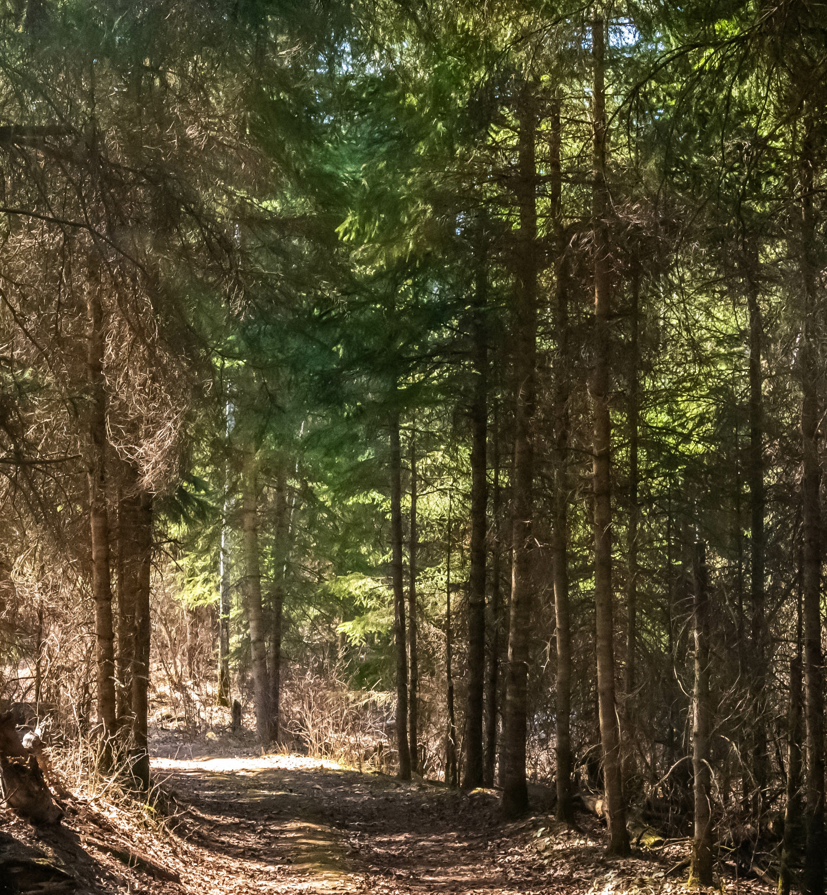
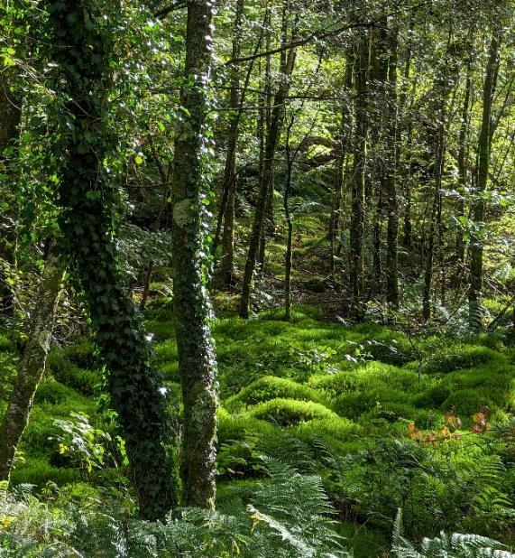
Woodlands
Evergreen
Broadleaved
Temperate rainforest
Notes:
Evergreen woodlands have mostly evergreen trees such as pine or spruce. These habitats tend to form in areas that get less rain and have colder, snowier winters.
Broadleaved woodlands have mostly broadleaved or deciduous trees such as oak or maple. These habitats tend to form in areas that get a bit more rain, and have warmer winters with less snow.
Temperate rainforests are woodlands that get much more rain. The trees are usually deciduous, and they are often covered in mosses and liverworts. These are special types of plants that grow very well in wet places. In addition to more rain, these habitats form in areas with mild winters and lots of humidity.

Slide 17
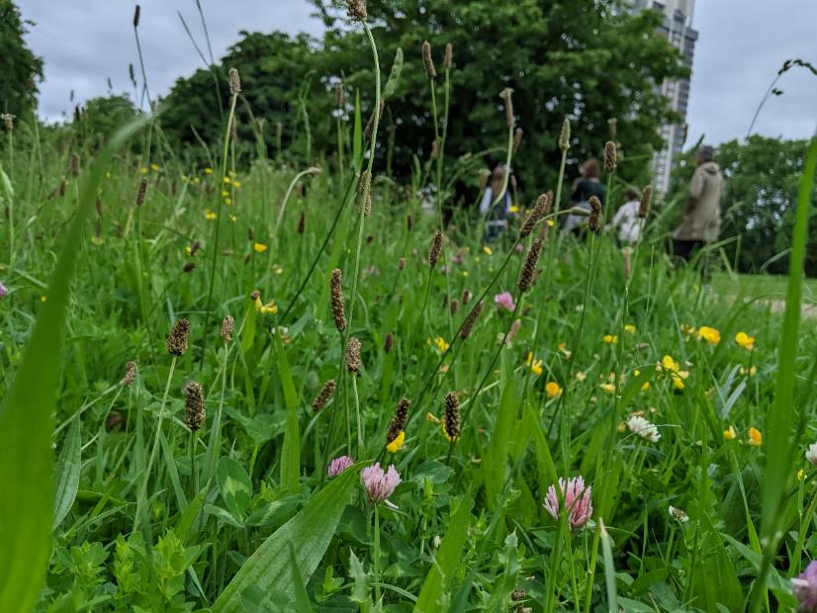
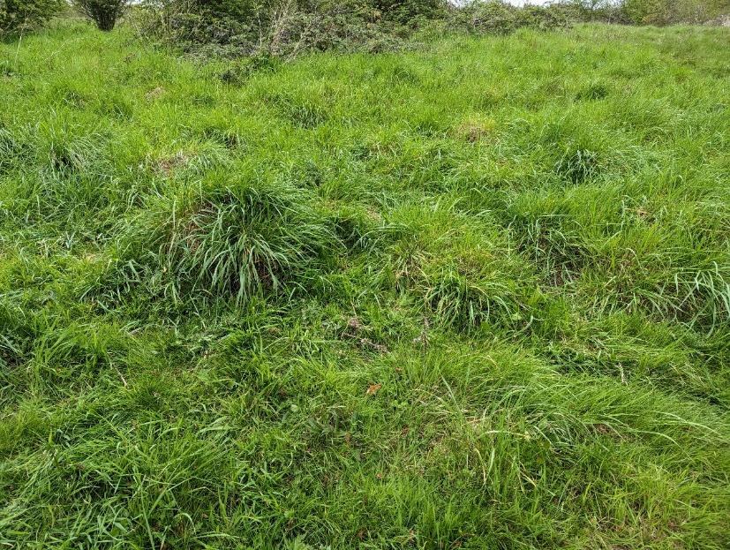
Grasslands
Meadow
Lawn
Notes:
Meadows are places with mostly short plants that don’t have trunks or stems made of wood. They have a mix of grasses and wildflowers.
Lawns are areas with mainly grasses. There are often few wildflowers because lawns are cut or mown which cuts off the leaves and growing parts of many types of wildflowers.

Slide 18
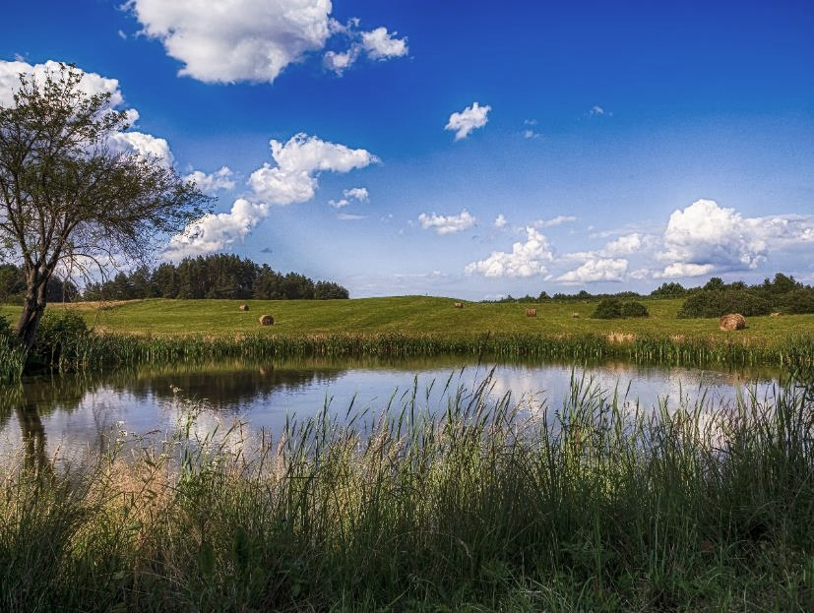
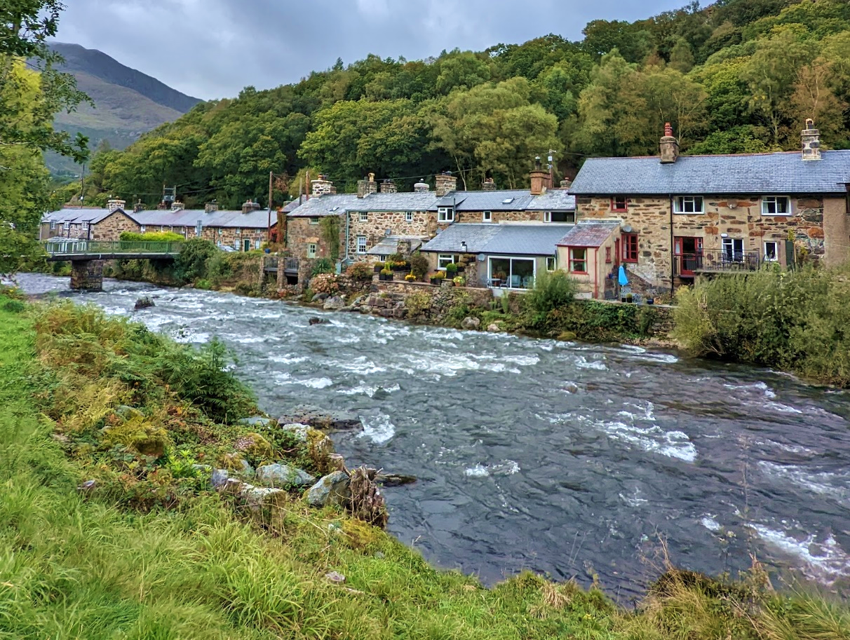
Wetlands
Pond
River
Notes:
Ponds have still water and are home to many types of floating plants and animals
Rivers have flowing or moving water. Things that live here need to be strong swimmers or be able to cling to rocks or gravel at the bottom of the river.

Slide 19
What habitats are around our school?

Slide 20
What plants and animals can we find living in the habitats around our school?

